Slide 1
NRLCA
Rural Carrier Benefit Plan (RCBP)
Minnesota Rural Letter Carriers’ Assn.

Slide 2
WELCOME AND CONGRATULATIONS
This presentation is a brief outline of the health plan available only to career employees who are members of the NRLCA

Slide 3
Career Conversion Class Attendees:
Congratulations on attaining career status with the United States Postal Service. You are now eligible for additional health benefits as a career employee. The Rural Carriers Union has an excellent health insurance program which you are eligible for as a union member. If you are not a member, please join and utilize the benefits. The RCBP is a closed plan available only to rural carriers. Because of this, they have been able to control the cost and provide excellent benefits. Please explore and consider what is available. I have put together some pages I have covering the program and some comparisons of cost of RCBP and a couple of the other popular plans available. The following pages of this presentation gives you the 2022 Coverage Summary of RCBP. The handouts give you many details and I am available to assist and answer questions.
State Sec/Treasurer Former State Sec/Treasurer
April Steidl Jim Obermoller
april.steidl@gmail.com jaobe@hotmail.com
320-766-5278 507-360-6100
Please email or call with your question.
If I cannot answer immediately,
I will return a call as soon as possible.

Slide 4
Rural Carrier Benefit Plan (RCBP) – High Option
The Rural Carrier Benefit Plan is sponsored by the National Rural Letter Carriers’ Association (NRLCA)
For nearly 60 years, the Rural Carrier Benefit Plan has proudly served the specific needs of NRLCA members and their families

Slide 5
Highlights of the RCBP
100% coverage for treatment of cancer
100% coverage for labs performed by Quest or LabCorp
100% coverage for maternity by in-network provider
100% coverage for preventive care by in-network provider
Large national network of 1.6 million providers
No cost 24/7 Nurseline
No cost telehealth through DialCare
No cost coverage at CVS Minute Clinics

Slide 6
Calendar year Deductible
A deductible is a fixed amount of covered expenses you must incur for certain covered services and supplies before the RCBP starts paying benefits.
In-Network
Self Only - $350
Self Plus one or Self and Family coverage - $700
Out-of-Network
Self Only - $800
Self Plus one or Self and Family coverage - $1600

Slide 7
Protection Against Catastrophic Costs
In-Network
$5,000 per person for Self Only enrollment
$10,000 for Self Plus one or Self and Family
enrollment per calendar year

Slide 8
Medical Services Provided by Physicians – 2022 Benefits
In-Network Coverage – You Pay
Office visit by primary care provider - $20 copayment
Office visit by specialist - $35 copayment
Surgery – 15% of Plan allowance
Preventive care – Nothing
Maternity care – Nothing
Diagnostic and treatment services provided in the office - 15% of Plan allowance (calendar year deductible applies)
Urgent Care Center - $35 copayment

Slide 9
Altnerative treatment – 2022 Benefits
In-Network Coverage – You Pay
Chiropractic care - $20 copayment (unlimited visits)
Massage therapy – 15% of Plan allowance (up to 30 visits)
Acupuncture – 15% of Plan allowance (up to 30 visits)

Slide 10
Services Provided by a Hospital – 2022 Benefits
In-Network Coverage – You Pay
Inpatient hospital - $200 copayment
Outpatient hospital – 15% (subject to calendar year deductible
Emergency room - $200 copayment (waived if accidental injury)

Slide 11
Cancer Coverage
RCBP pays 100% of the Plan allowance for drugs, services and supplies for treatment of an illness diagnosed as cancer.
The service or supply must be for the treatment of a malignancy. A diagnosis secondary to cancer is not covered under this benefit.
The RCBP is the only plan in the federal program with this coverage.

Slide 12
Quest and LabCorp
When you use Quest or LabCorp, you pay nothing for covered labwork

Slide 13
Mental Health & Substance Abuse - 2022 Benefits
Your cost-sharing responsibilities are no greater than for other illnesses or conditions

Slide 14
DENTAL
After a deductible of $50 per person during the calendar year, the Plan pays a set amount for all services.
There is no annual limit on the amount of services you receive.
Note: You are responsible for all charges that exceed the Plan's scheduled allowance for the service listed below.
The RCBP is medical policy, not a dental policy and benefits are based on a limited fee schedule.

Slide 15
Fee Schedule Examples
Oral Exams $12.50
Cleaning $22.00
X Rays $34.00

Slide 16
Fee Schedule
Restorations -
1 surface permanent $14.00
2 surface permanent $20.50
3 or more surface permanent $26.50
Gold restoration $103.50
Extractions -
Single tooth $16.00
Pulp capping-direct $9.50
Pulpotomy-vital $21.00

Slide 17
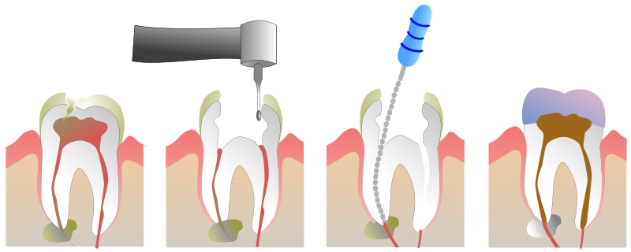
Root canal therapy
This includes the actual root canal treatment and any replacements:
One root $106.00
Two roots $126.00
Three or more roots $170.00
Periodontal scaling and root planning - $26.50
Crowns/abutments - $120.00
Dentures- $126.00 - $157.00 depending on procedure

Slide 18
Prescription Drugs – 2022 Benefits
Nationwide access to CVS/Caremark network pharmacies.
Coverage for FDA-approved medications.
CVS/Caremark mail order
CVS retail pharmacies —get up to a 90-day supply of a maintenance medication at the mail order copayment

Slide 19
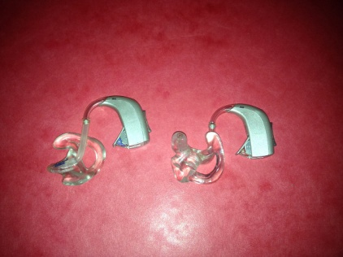
Hearing Aid Coverage
Enhanced coverage of $3000 every 3 years
Was every 5 years

Slide 20
Prescription Benefits

Slide 21
Telehealth Services
DialCare is RCBP’s telehealth vendor
Doctors of Medicine
Licensed mental health professionals
Call 855-335-2255 or visit dialcare.com/verify
24/7 nurse advice line
Call 1-800-556-1555
CVS MinuteClinic visits
Visit any local CVS MinuteClinic and present your RCBP ID card
All covered at no cost to you!

Slide 22
No Cost Programs Available to RCBP Members
Bone and Joint Program
AbleTo
Care Management
Transform Diabetes
Accordant
Pinnacle Care
Health Coaching
Sleep Program

Slide 23
Back and Joint Program through Hinge Health
Digital exercise/home physical therapy program
Once enrolled you will receive:
Tablet
Wearable sensors
Personalized exercise therapy
Unlimited 1:1 health coaching
To learn more, call 855-902-2777 or visit: hingehealth.com/rcbp-2022

Slide 24
AbleTo
A web-based video conferencing personalized eight-week treatment support program designed to address unique emotional and behavioral health needs.
Learning to live with conditions such as heart disease, type 2 diabetes, chronic pain or life events.
To learn more, call AbleTo at 866-287-1802 or visit ableto.com/enroll

Slide 25
Care Management
Our care management program offers:
1:1 support with a clinical nurse
Digital support
Customized health actions based on your needs
Personalized communications
Includes programs such as:
Behavioral health support
Cancer support
Compassionate care
Social work

Slide 26
Transform Diabetes Program
Provides personalized support through a cellular enabled meter, mobile app, and personalized interventions to help diabetes management. The program provides:
Unlimited blood glucose test strips and lancets.
In Touch® glucose meter that tracks strip usage and prompts members with supplies.
Real-time interventions by Certified Diabetes Educators for members with dangerous (high and/or low) blood sugar levels
For more information contact 800-292-4182

Slide 27
Accordant
Offers programs for the complex chronic medical conditions such as:
Rheumatoid Arthritis
Chron’s Disease
Multiple Sclerosis
ALS
Chronic Kidney Disease
For more information call 866-380-6295

Slide 28
PinnacleCare
Provides expert medical guidance when faced with a serious or complicated medical condition.
Help find the right specialist
Obtain a second opinion
Navigate the medical system
Expert medical opinion/confirmation of your diagnosis
Research on your diagnosis and treatment options
Customized report identifying top local, regional, or national specialists to fit your needs
Facilitates appointments with top specialists or Centers of Excellence
Gathering, organizing, and forwarding of your key medical records
For more information, call 888-442-7380 or visit PinnacleCare.com/support.

Slide 29
Health Coaching Program through Trestle Tree
Provides the opportunity to work one-on-one with Health Coach to improve your health. Your Health Coach will provide guidance, support, and resources You can talk to a Health Coach about the following health-related matters:
Tobacco cessation
Weight management
Exercise
Nutrition
Stress management
For more information call 855-553-5109. You may also enroll online at enroll.trestletree.com (passcode: RCBP).

Slide 30
Sleep Program through Sleepio
An online/digital sleep improvement program proven to help you clear your mind and improve your sleep
To learn more, visit sleepio.com/RCBP

Slide 31
Wellness Incentives
Each covered member over the age of 18 can earn up to $400 in rewards each calendar year! Rewards are loaded on a Payflex debit card
$100 - Complete the Health Risk Assessment (HRA)
$100 - Complete a biometric screening through Quest Diagnostics and have your annual exam
$50 per incentive for:
Receiving prenatal care for members who are pregnant
Controlling blood pressure for members with high blood pressure
Controlling A1C levels for members with diabetes
Tobacco users who eliminate tobacco

Slide 32
Wellness Incentives
Complete any of the following Healthy Actions earn additional incentives:
Get your breast cancer screening and earn $50
Get your cervical cancer screening (pap smear) and earn $50
Get your colorectal cancer screening and earn $50
Get your flu shot and earn $25
Participate in our Telephonic Health Coaching Program and complete 6 coaching sessions (see elsewhere in this section) and earn $75
Select a primary care physician (PCP) and earn $25
After you complete each activity, the plan will deposit the amount earned onto your PayFlex Debit Card. Your account can reimburse you for your cost-sharing amounts (such as deductibles, coinsurance and copays) and certain “Eligible Medical Expenses” approved by the IRS.

Slide 33
Online Tools
The app is available on the App Store® and Google Play

Slide 34
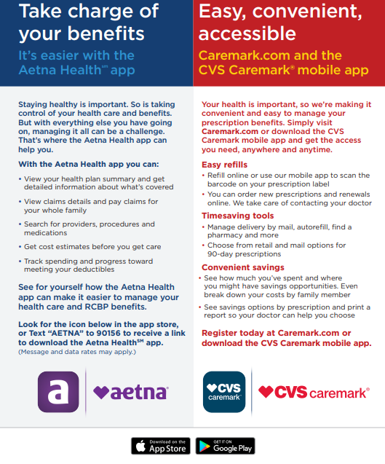
Mobile Apps

Slide 35
Resources
www.nrlca.org - NRLCA magazine on website – especially the April and August issues.
www.rcbphealth.com – Has a variety of information including forms, documents, health and wellness resources, and a link to register for your Aetna member website. Next time you’re searching for information regarding the Rural Carrier Benefit Plan, look no further than RCBPhealth.com.
www.mnrlca.org – MNRLCA’s website.

Slide 36
www.nrlca.org
Sign into web site:
- Go to departments
-Then to insurance.

Slide 37
Rural Carrier Benefit Plan Rates For 2023
 | CODE | (Biweekly) | Retiree(monthly)
Self Only | 381 | 130.98 | 283.79
Self and Family | 382 | 243.23 | 527.00
Self Plus One | 383 | 253.14 | 548.47
BCBS Standard (equivalent to RCHBP)
Self Only | 104 | 142.40 | 308.53
Self and Family | 105 | 347.89 | 753.77
Self Plus One | 106 | 318.85 | 690.84

Slide 38
Comparison chart
 | 2023 | 2022 | Rate change
Self Only | 130.98 | 130.81 | +.17
Self and Family | 243.23 | 236.89 | +6.34
Self Plus One | 253.14 | 247.49 | +5.65
BCBS Standard (equivalent to RCHBP)
Self Only | 142.40 | 127.47 | +15.00
Self and Family | 347.89 | 314.11 | +33.78
Self Plus One | 318.85 | 289.61 | +29.24

Slide 39
Comparison chart
 | RCBP | BCBS | SAVINGS
Self and Family | 243.23 | 347.89 | 104.66
SAVINGS IN A YEAR $2721.16

Slide 40
State Sec/Treasurer
April Steidl
319 1st Street
Miltona, MN 56354-4001
320-766-5278
april.steidl@gmail.com
Former State Sec/Treasurer
James A Obermoller
184 Railroad Ave
Round Lake, MN 56167-9775
cell 507-360-6100
jaobe@hotmail.com
Dan Sundvall
18729 Cassie Ln
Pine City, MN 55063
Phone 763-360-2876
dsundvall@comcast.net

