Slide 1
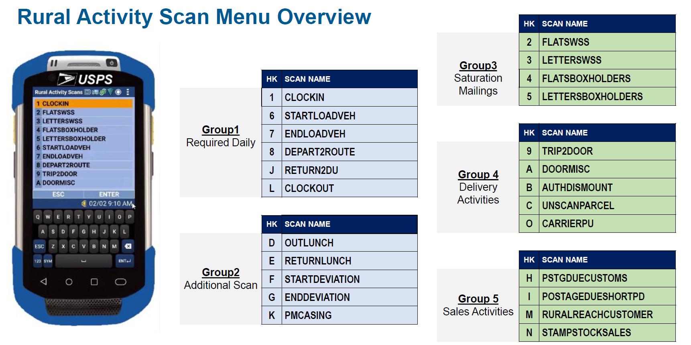

Slide 2
RRECS Scans for Route
Notes:
Carriers assigned to full routes as the primary carrier need to perform all 6 daily scans
Split routes only require start load and end load…
If the concern is about casing times, individuals should know that casing time is based on the avg mail volumes per route and not anything that is currently entered through MDD scans or in RRECS system
If the concern is about time keeping, timekeeping is still maintained through the 4240, which is why they do not have to worry about clocking in or clocking out on split routes. Which is why a clock in and clock out are not required.
If the concern is the delivery time evaluation, the split route will get the avg evaluation time for delivery time for that same day (Tuesday gets Tuesday Avg, Friday gets Friday Avg, etc.). Which is why they don’t need the depart 2 route and return 2 office

Slide 3
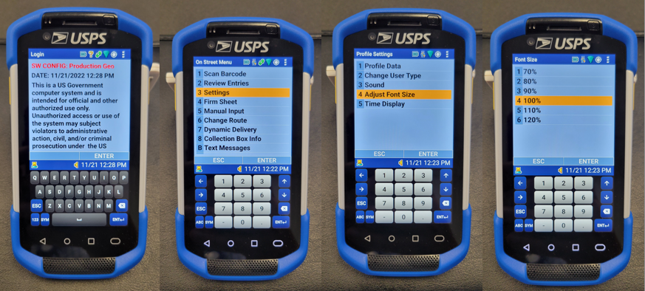
Change Sensitivity
1) Log-into your Scanner
2) From the Main Menu Screen go to the Settings Option
3) Select Adjust Font Size
4) Select Option 6 for 120%

Slide 4
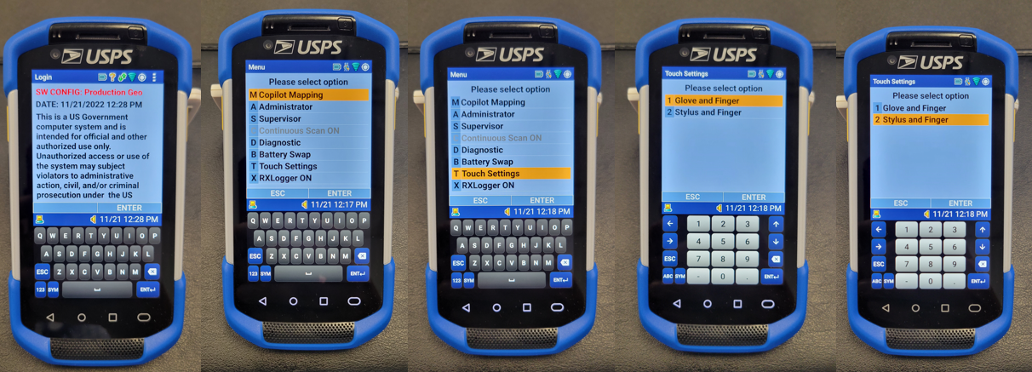
Change Font Size
1) Select the Menu from the top right
2) Scroll down or use option T for Touch Settings
3) Change Settings to desired sensitivity

